Slide 1


Telescope Autofocuser
Albin Myscich
Alonna Too-Chiobi
Camille Watson
Joseph Basdeo

Slide 2
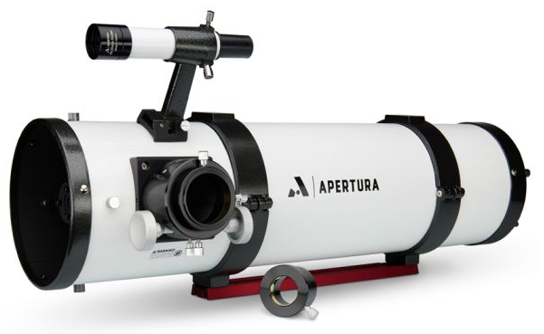
Project Description
Problem:
Telescope focusing & image processing automation
Motivation:
Open-source community contributions
Beginner friendly hobby exploration
Low-light environment support
Disability assistance
Image yield optimization

Slide 3
Project Description
Software Interfacing
Image Post-processing
Real-time Sub-system Software Modulation
Hardware Interfacing
Focuser Automation
Power Supply & Redundancy
Aesthetics and Sub-system Interfacing
Hardware Protection & Mount Assembly
Sub-system Installment & 3D Print Design

Slide 4
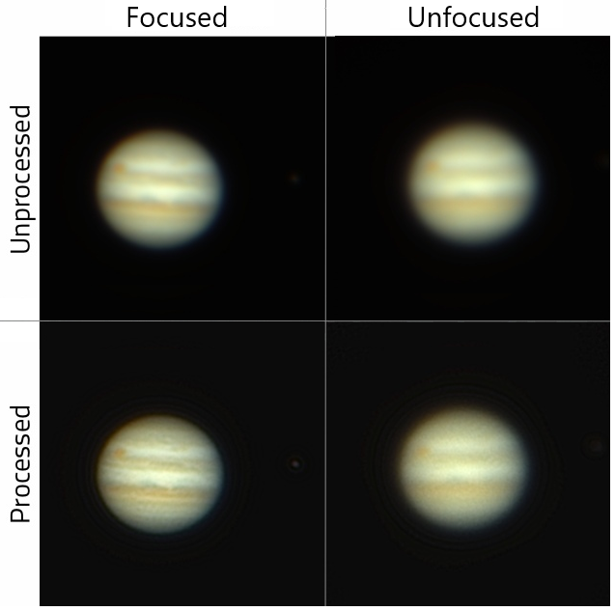
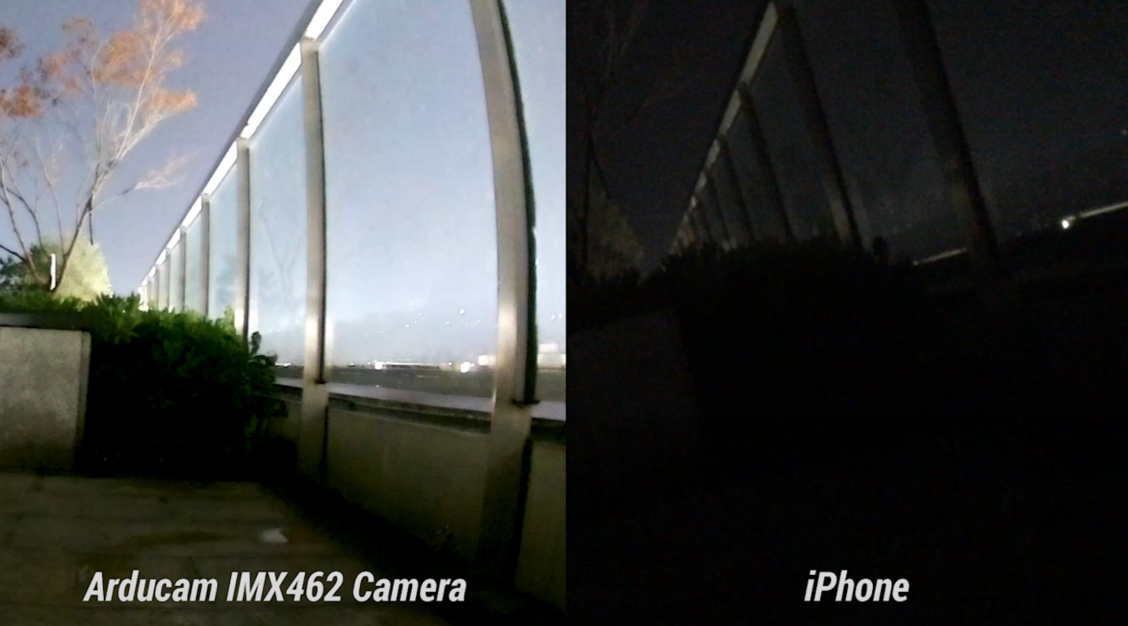
Project Description

Slide 5
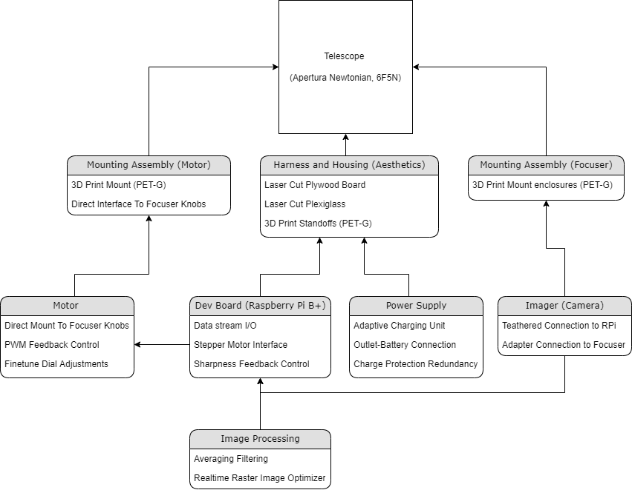
Project Design

Slide 6
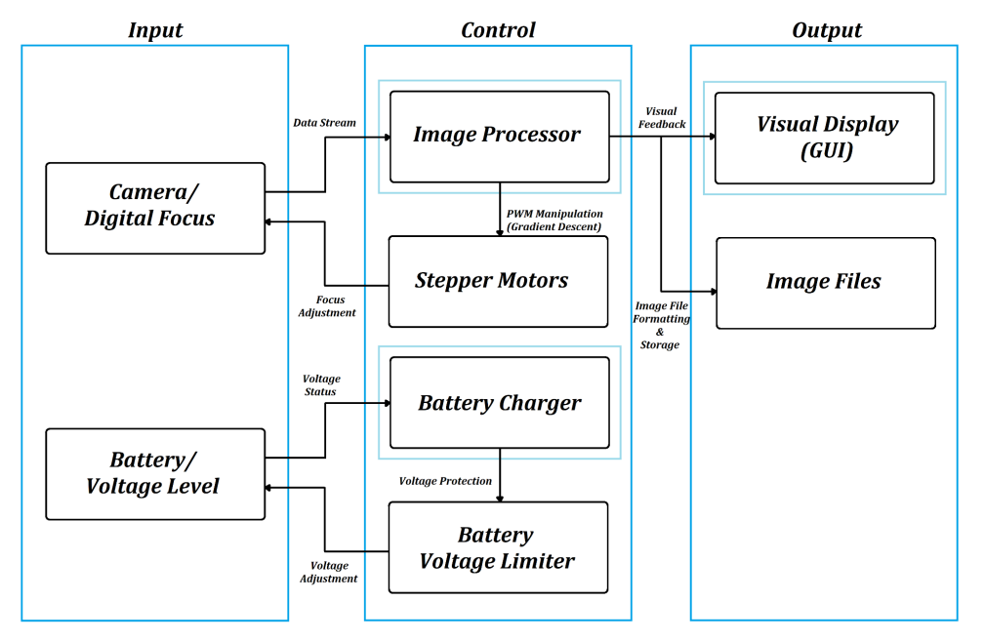
Project Design

Slide 7
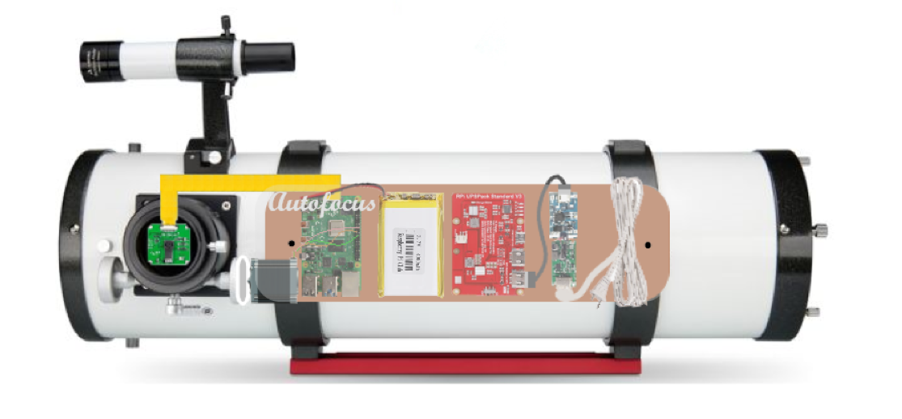
Project Design

Slide 8
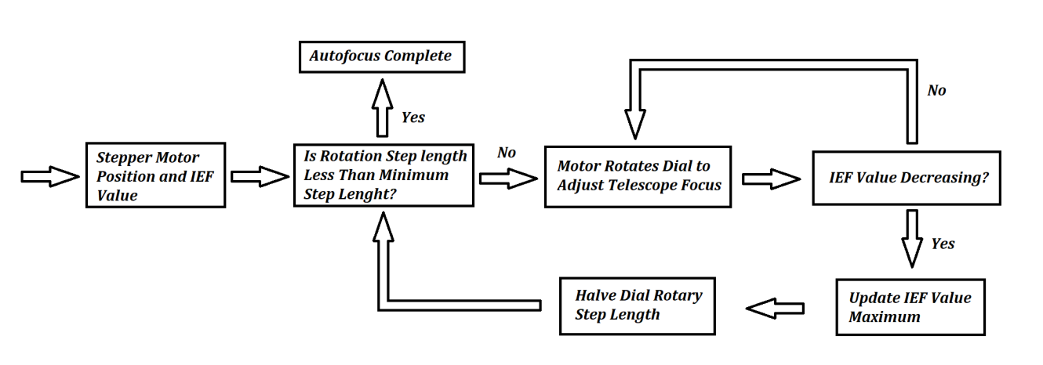

Slide 9
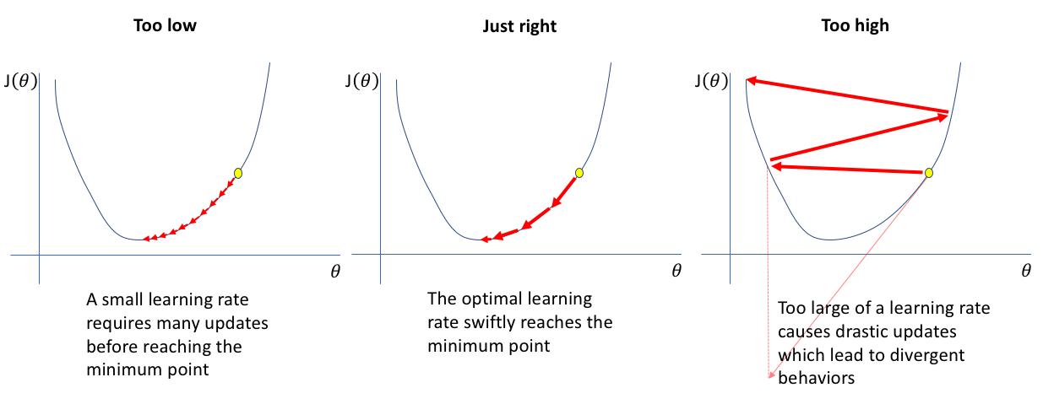
Notes:
Image adapted from the medium article: https://medium.com/swlh/an-overview-of-gradient-descent-algorithms-9701b3eb8ce3

Slide 10
Task Partition
Albin Myscich | Image Post-processing Real-time Sub-system Software Modulation Focuser Automation
Alonna Too-Chiobi | Motor & Mounting Assembly
Camille Watson | Power Interfacing & Redundancy Aesthetic Enhancements
Joseph Basdeo | Imager & Mounting Assembly

Slide 11
Execution plan
Subsystem | Timeline
Dev Board/Programming Machine Learning Optimization Statistical Image Optimization Stepper-motor Interface Q/A Testing | 2/24/22 - 3/12/22 3/13/22 - 3/30/22 3/31/22 - 4/15/22 4/16/22 - 4/23/22
Dev Board Mount Measure and Design Mount Dimensions Laser Cut Mounts Design Standoffs (CAD) 3D Print Standoffs Assembly & Mount | 2/24/22 - 3/9/22 3/10/22 - 3/11/22 3/12/22 - 3/25/22 3/26/22 - 3/27/22 3/28/22 - 4/10/22
Power Supply Design Charging-Battery Interface Design Redundancy System Charging-Battery Assembly Q/A Testing | 2/24/22 - 3/16/22 3/17/22 - 4/6/22 4/7/22 - 4/15/22 4/16/22 - 4/23/22
Motors Design Motor Mounts (CAD) 3D Print Motor Mounts Design Stepper Motor PWM interface Q/A Testing | 2/24/22 - 3/16/22 3/17/22 - 3/18/22 3/19/22 - 4/8/22 4/9/22 - 4/16/22
Imaging Design Imager Mount (CAD) 3D Print Imager Mount Design I/O Data Streaming Interface Q/A Testing | 2/24/22 - 3/16/22 3/17/22 - 3/18/22 3/19/22 - 4/9/22 4/10/22 - 4/17/22

Slide 12
Validation plan
Subsystem | Criteria
Dev Board/Programming Machine Learning Optimization Statistical Image Optimization Stepper-motor Interface | Algorithm sorts images and chooses most focused? Is performance increased by stacking more than 10 images? Can interface move stepper motor interface by a specific margin?
Dev Board Mount Measure and Design Mount Dimensions Laser Cut Mounts Design Standoffs (CAD) 3D Print Standoffs Assembly & Mount | Do dimensions operate within the constraints of the telescope? Are parts the same dimensions as designed? Do dimensions of standoffs operate within the constraints of the telescope? Are the dimensions of parts accurate with the CAD design? All Tasks are passed in subsystem
Power Supply Design Charging-Battery Interface Design Redundancy System Implement Power Circuit Charging-Battery Assembly | Is voltage at max after charging battery? Does each component receive operational values without damaging system components? Does each component receive operational values without damaging system components? Does measurements assembly fit within constraints of the telescope?
Motors Design Motor Mounts (CAD) 3D Print Motor Mounts Design Stepper Motor PWM interface Motor Quality | Do dimensions operate within the constraints of the telescope? Are parts the same dimensions as designed? Does motor operate on specific speeds and positions? Does motor operate without damaging the motor mount and assembly subsystem?
Imaging Design Imager Mount (CAD) 3D Print Imager Mount Image Quality Design I/O Data Streaming Interface | Do dimensions operate within the constraints of the telescope? Are parts the same dimensions as designed? Does image fit desired image specifications (resolution, pixel width, and quantum efficiency) Can imager receive an image and transmit to Raspberry Pi under 5ms
Notes:
Q/A Testing is expected for each section and will support the quality of work produced this semester leading in the next.

Slide 13
Part Order Status
Part | Status
Arducam Pivariety Ultra Low Light IMX462 Camera | Order placed
1/4 in. x 1 ft. x 1.5 ft. Birch Plywood Project Panel | In-Store Pick-up
18 in. x 24 in. x 0.093 in. Clear Acrylic Sheet Glass Replacement | In-Store Pick-up
Raspberry Pi 1 Model B+ | In Possession
Jumper Wires Ribbon Cables Kit | In Possession
PETG filament (White/Black) | In Possession
Nema 17 Bipolar 1.8deg 26Ncm (36.8oz.in) 0.4A 12V 42x42x34mm 4 Wires (Stepper Motor) | Order Placed
Digital Stepper Drive 1.0-3.2A 18-30 VDC for Nema 17, 23 Stepper Motor | Order Placed
12V, 8300mAh Li-Ion battery | Order Pending
5V, 3000 mAh Li-Po battery | Order Pending
Apertura 2" Photo & Visual Coma Corrector for Newtonian Telescopes - A-COMA | Order Pending
12V Battery Under Voltage Cut off Automatic Switch On Recovery Protection | Order Pending

Slide 14
Q/A

